Slide 1
LESSON 16
Hardhat Upgrades

Slide 2
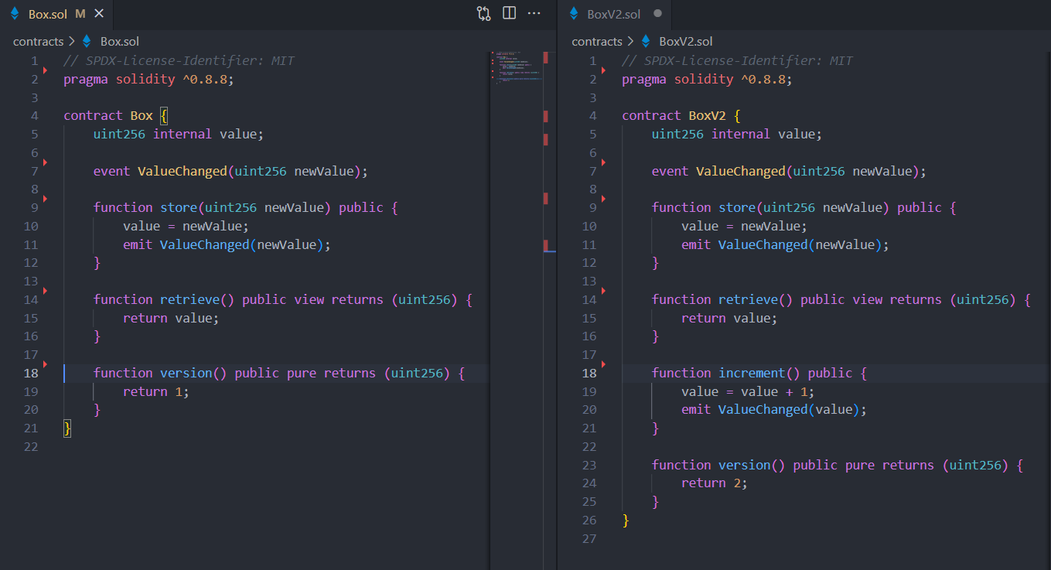
Contracts

Slide 3
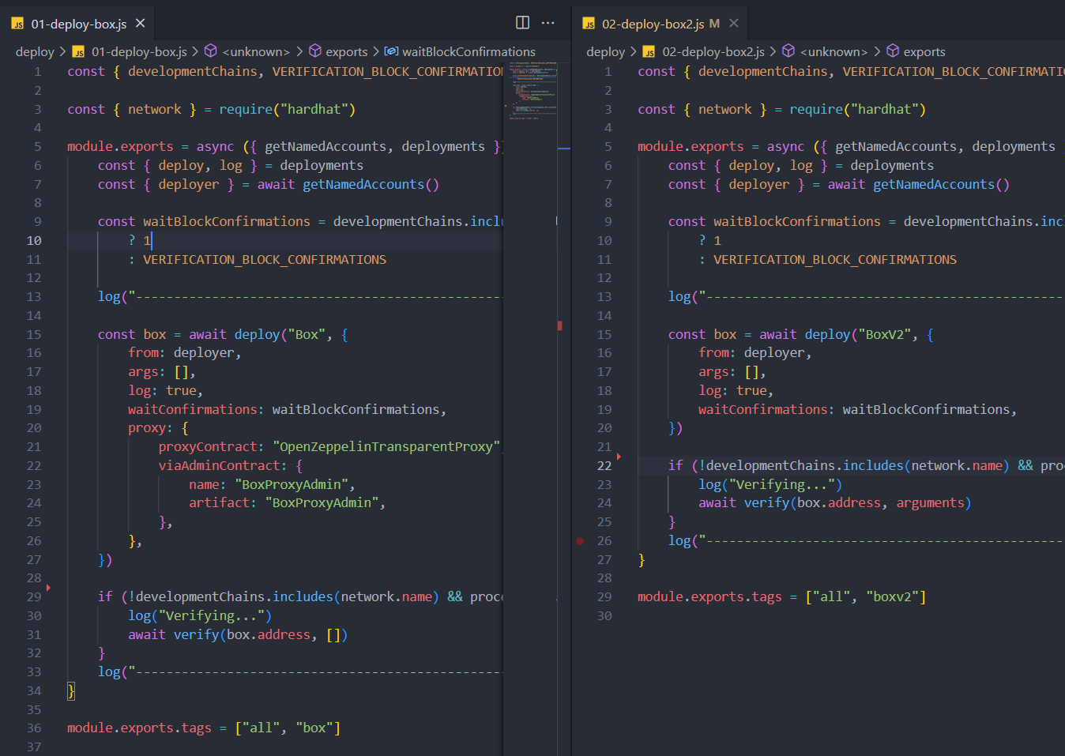
Deploy

Slide 4
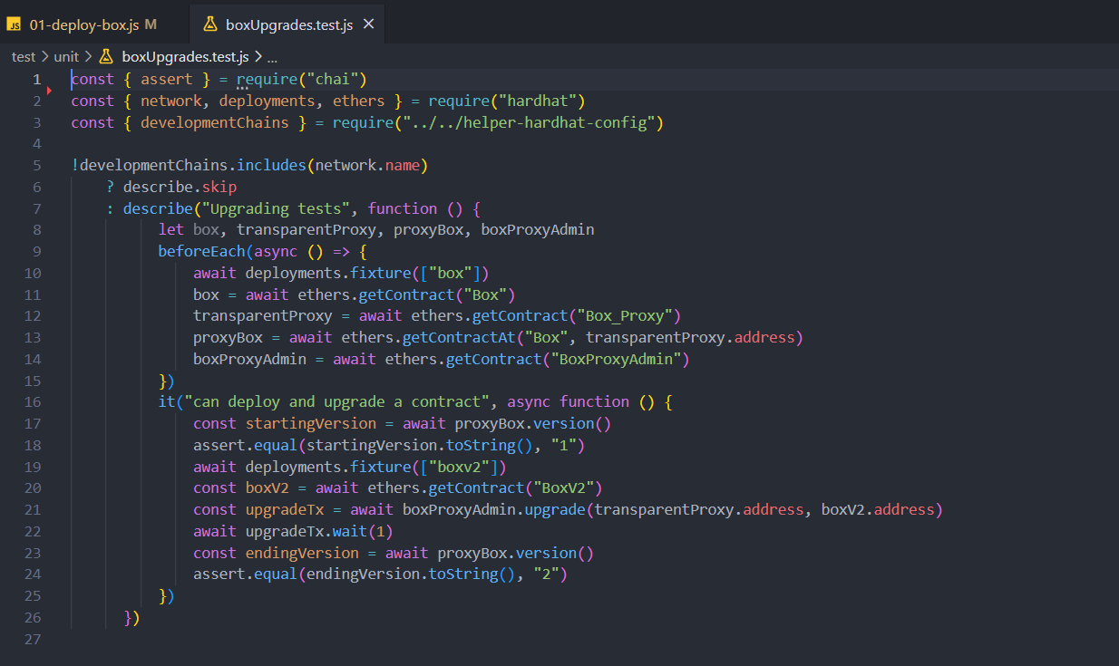
Testing

Slide 5
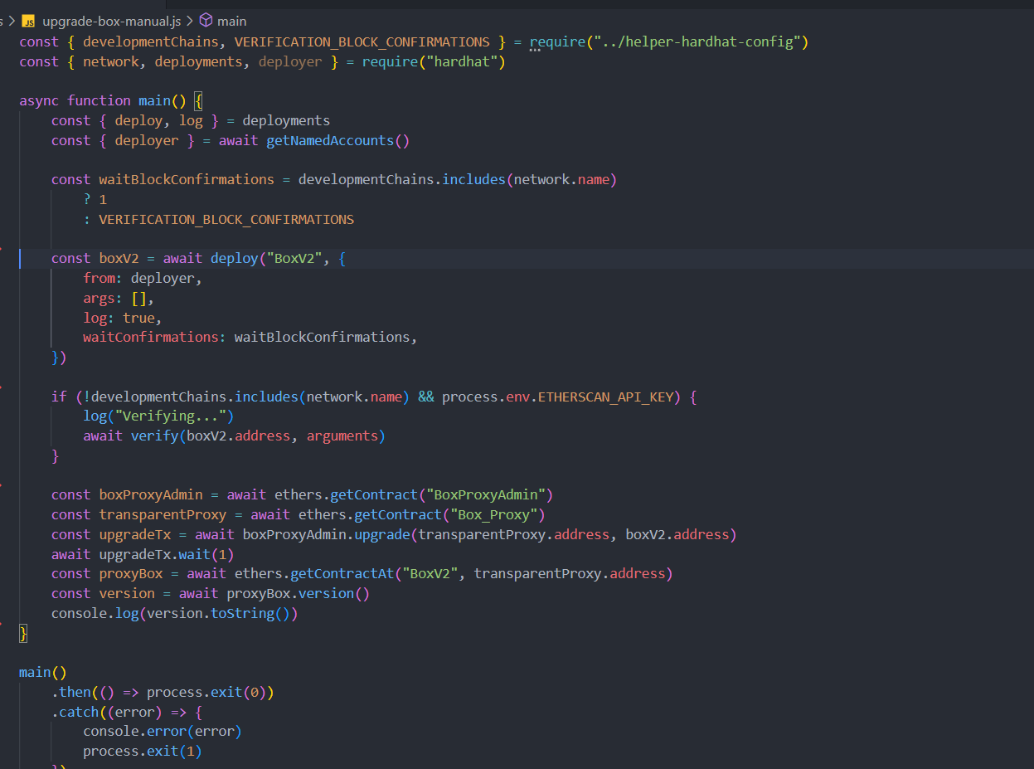
Scripts

